Slide 1

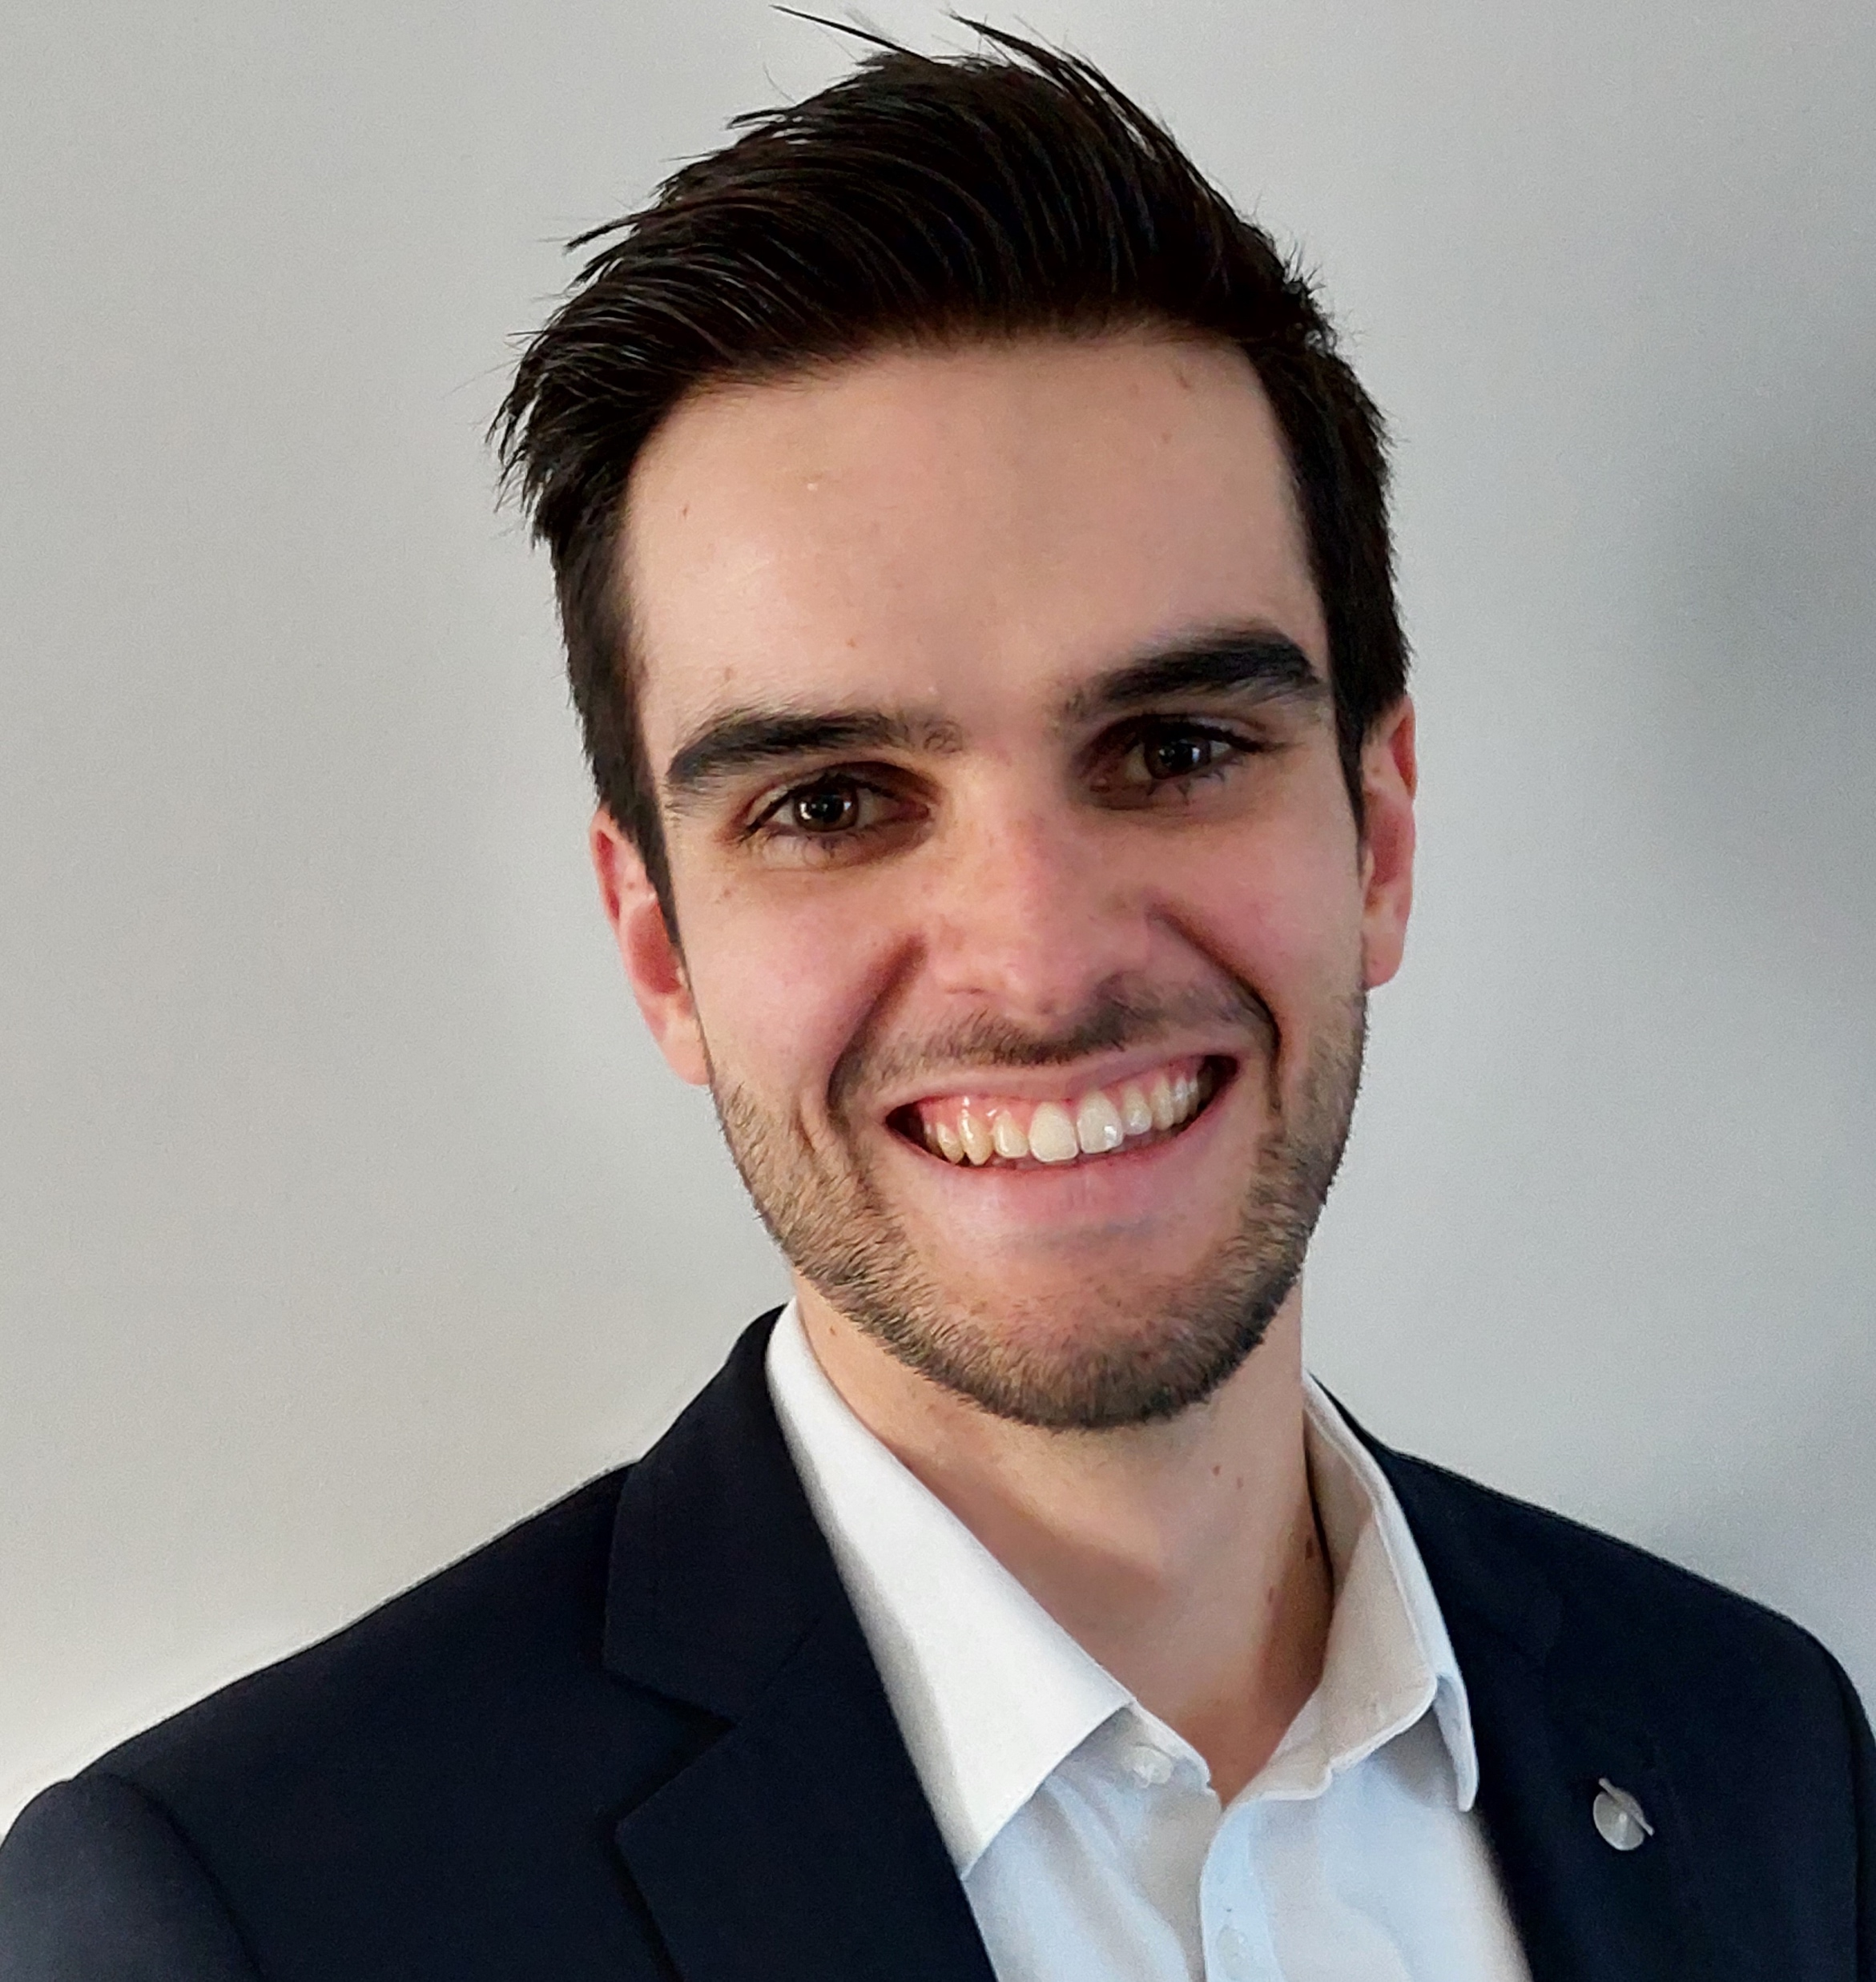
Software IP protection and copyright DROIT-IP Law – March 26th, 2024
Thomas Le Goff
Assistant Professor of Law & Technology

Slide 2
Structure
Software as IP (30 min)
IP rights and software
Focus on copyright protection and originality of software
Software and open source (20 min)
What is Open Source?
Overview of popular open source licenses: GPL, Apache, creative commons…
Serious game: invent and defend your software! (1h45)

Slide 3
Software as IP

Slide 4
Types of IP rights and software
PATENTS
“The exclusive right to produce, use, and sell an invention”.
To qualify for a patent in the EU, you need to demonstrate that your invention meets the following requirements:
Industrial application: non-abstract and applicable to all types of industry.
Novelty: the technical features of the invention are not included in the prior art.
Inventive step: the technical features of the invention must not be obvious from the knowledge (alone or in combination) of the prior art.
Patents generally expire after a given period — usually 20 years.
Software is not patentable (along with scientific theories, mathematical or economic methods, remember: ideas are not protectable!)
But the process that produces a technical effect, implemented by a software, is patentable (example: Metroscope)

Slide 5
Types of IP rights and software
COPYRIGHT
Protects the specific expression of intellectual and original work.
Gives the owner the exclusive right to copy, modify, and distribute or sell those copies or modifications to the public.
Needs no application process (unlike patents). Copyright is automatically obtained by the creation of the original work.
Covers the specific code used in the program or elements in the user interface.
Usually applicable for the duration of the copyright owner’s life plus 50 years, or 75 years (France).

Slide 6
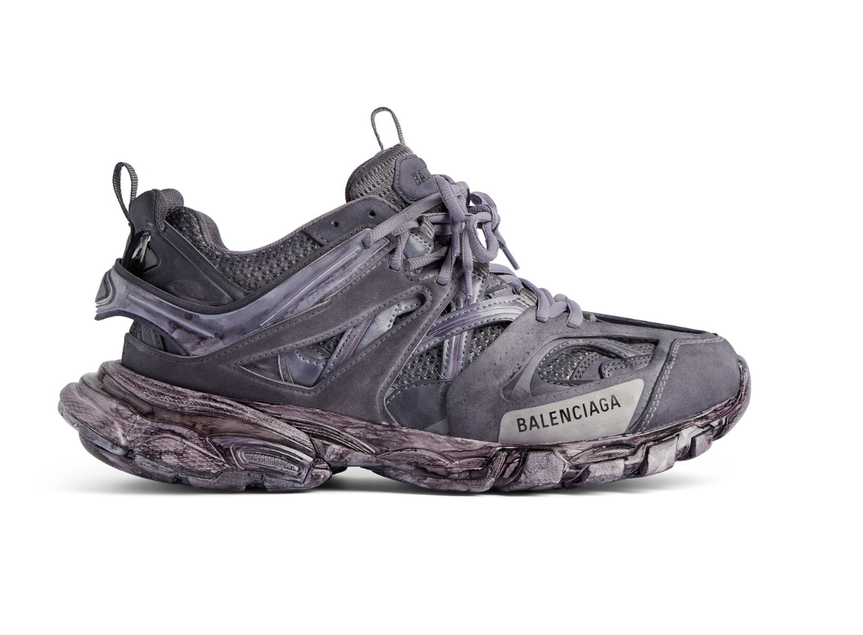
Types of IP rights and software
TRADE SECRET
“a process, tool, mechanism, or formula that is not publicly available and is kept secret by its owner, i.e. the unique design of a Balenciaga shoe would fall under copyright or specific design law, while the special way the manufacturer produces the shoe would be considered a trade secret because the competitor can’t discover it just by studying or taking apart the finished product.
Protected by law as long as the owner makes reasonable effort to keep it a secret and no one else has discovered it independently. It’s illegal for someone to spy on your company and steal a trade secret, but if they figure it out by reverse engineering or by developing it themselves, it’s fair game.
In the EU, trade secret is protected by specific laws and in France by the Code de commerce (owner should demonstrate the commercial value of the information covered by secret, the existence of a secret and of concrete measures to protect the secret).
Could be used to protect software code.

Slide 7
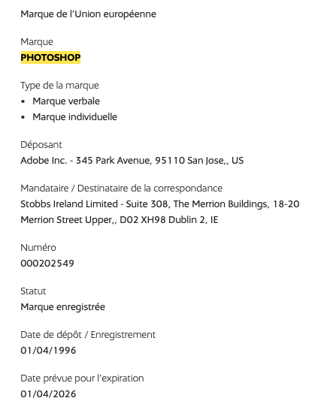
Types of IP rights and software
TRADEMARKS
“a symbol, phrase, name, or other type of expression used to distinguish a particular product or brand”. Names of brands or products are often marked as trademarks using a trademark symbol: ™ for unregistered trademarks, and ® for registered ones.
This can protect the “name”/trademark under which the software is sold (i.e. “Photoshop”)

Slide 8
When is my software copyrighted?
To be copyrighted, intellectual works have to be « original » (Court of Justice of the European Union, Case C-5/08, Infopaq 16th July 2009 ; art L112-1 Intellectual Property Code).
Thus, an algorithm « a simple succession of operations translating a logical statement of functionalities, is insusceptible of protection » (Cour d’appel de Paris, 8 septembre 2017) : Do you agree with that conclusion?
How to demonstrate « originality »?
The author needs to demonstrate « a personalized effort going beyond the simple implementation of an automatic and constraining logic, and that the materialization of this effort resided in an unique structure" that bears "the mark of his intellectual contribution » (Cour de cassation, arrêt PACHOT, 7 mars 1986).
Show « how the choices made demonstrated the intellectual contribution and personal effort of the person who developed the software, which alone conferred the character of an original work protected by copyright » (Cour de cassation, 17 octobre 2012).
« The elements likely to justify the originality of the software's component » are the « programming lines, codes or flowchart, or preparatory design material » (Cour de cassation, 14 novembre 2013).
Who owns the rights?
« Moral » rights => to the author
Software specificity: limited to the rights of disclosure (decide on publication) and authorship (attach the author’s name to the work). Withdrawal, repentance and forbidding forward modification by an editor are excluded.
« Patrimonial » rights (exploitation, royalties…) => to the author, except: employees’ invention (employer), collective invention (co-authors), collaborative work (1 author for each detachable component of the work).

Slide 9
Software users’ rights
Specific users’ rights (art L122-6-1 Intellectual Property Code)
Right to make reproductions, translations or adaptations « necessary to enable the software to be used, in accordance with its intended purpose, by the person entitled to use it, including to correct errors », unless the user contract stipulates otherwise.
Right to make a backup copy.
Right to observe and test the software and its security to determine its principles.
Right to access the software code if this is essential to ensure interoperability with other software, on condition that the information required for interoperability is not already available, and that this act is limited to the parts of the code concerned by this interoperability.

Slide 10


Originality of software: examples
A software performing a purely functional task
i.e. a software of e-signature for a notary, which only affix a signature at a bottom of a page
A software performing a simple task with an innovative feature
i.e. a software of e-signature for notary, which allows users to sign by verifying their identity through the blockchain
A software performing a complex task which has required an entire team to develop or specific skills/innovative ideas
i.e. a software all-in-one for e-signature and document authentification through the blockchain
The more you can demonstrate that your approach is original or unique, the stronger will be your argument to defend that your software is protected by copyright!

Slide 11
Software and Open Source

Slide 12
Software and open source
The philosophy of open source (see The Open Source Definition)
Openness fosters innovation ! What do you think? What are the benefits and pitfalls of open source?
Founding principles:
Free Redistribution: no royalty
Source Code included
Modifications and Derived Works allowed
Integrity of the Author’s Source Code: distribution of « patch files »
No Discrimination Against Persons or Groups
No Discrimination Against Fields of Activities
Distribution of License: no need for additional license for ulterior users
License Must Not Be Specific to a Product
License Must Not Restrict Other Software (which could be distributed along with the licensed software)
License Must Be Technology-Neutral: no provision specific to an individual technology or interface
The concept of « copyleft »
« the rule that when redistributing the program, you cannot add restrictions to deny other people the central freedoms »
(Source: GNU project)
« the legal technique of granting certain freedoms over copies of copyrighted works with the requirement that the same rights be preserved in derivative works. »
(Source: Wikipedia)

Slide 13
Overview of popular open source licenses
(Source: Carnegie Mellon University: https://www.cmu.edu/cttec/forms/opensourcelicensegridv1.pdf)
Creative commons licenses = CC + XX-YY…
CC BY: free usage, including commercial use. BY = Credit must be given to the creator
CC BY-SA: free usage, including commercial use. BY + SA = Adaptations shared under the same terms
CC BY-NC: BY + NC = no commercial use.
CC BY-NC-SA: BY + NC + SA
CC BY-ND: commercial use allowed, credit to the author but no derivatives or adaptations are permitted
CC BY-NC-ND: no commercial use + no derivative

Slide 14
Serious game: invent and defend your software!

Slide 15
The IP game
MAKE GROUPS ! 4 to 6 (ideally 6 groups)
45 minutes preparation (10h – 10h45) + 5 to 10 minutes talks (10h45 – 11h45)
Then, each group comes on stage and presents its argument (1 or several speakers, as you wish, slides allowed – although not compulsory)
THE PITCH
You represent the software design development team of a tech company or start-up in the field of your choice, which has developed a state-of-the-art software capable of disrupting your field.
Few days after your public announcement, your main competitor announces that he developed a new cutting-edge software presenting the same functionalities as yours and starts selling it at a very low price. The vast majority of your clients who pre-ordered your product cancelled their ordering, making you uncertain to have sufficient revenue to continue to commercialize it. You suspect one of your former intern, who worked on the project and then have been hired by your competitor to have reproduced your source code with minimal changes.
You went to your lawyer who recommended you to go to court for copyright infringement. However, he warns you: in these types of claim, the defendant will most probably argue that your software does not fulfil the “originality” criteria for copyright protection. You need to prepare yourself and to be able to demonstrate that your software is protected by copyright.
WHAT YOU NEED TO DO
Invent a software that could be protected by copyright. You need to:
Find an original idea of a software.
Choose a field of activity (quality management in industry, office suite, car-sharing mobile app…) and
Describe the main functionalities of your software.
Build an argument to demonstrate the originality of your software (you need to demonstrate the originality of your design choices and that your software does not only perform its task correctly but is the result of a creative work done by your team). Be creative and convincing, you’ll then present to the class (the ”court”) your argument (slides allowed).
The court is allowed to ask questions and advance counter arguments after your presentation (gives extra participation points).
Bonus: using other IP rights give you extra-points.
WHAT YOU GET
Best group gets +1 on their final grade ; Each speaker gets a « star » in participation (meaning no malus on the final grade and potential bonus depending on quality).

